Slide 1

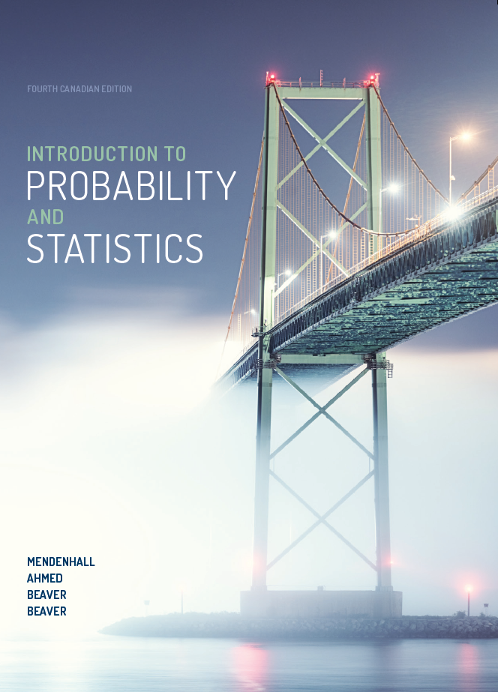
NETA PowerPoint® Slides
to accompany
Introduction to Probability and Statistics, 4Ce
Revised for the
Canadian edition by
Cristina Anton
Grant MacEwan University

Slide 2
CHAPTER 1
Describing Data with Graphs

Slide 3
Variables and Data
Variable: a characteristic that changes or varies over time and/or for different individuals or objects under consideration
Examples:
hair colour, white blood cell count, time to
failure of a computer component

Slide 4
Definitions, continued
Experimental unit: the individual or object on which a variable is measured
Measurement: results when a variable is actually measured on an experimental unit
A set of measurements, called data, can be either a sample or a population

Slide 5
Definitions
Population: the set of all measurements of interest to the investigator
Sample: a subset of measurements selected from the population of interest

Slide 6
Examples
Variable
Hair colour
Experimental unit
Person
Typical measurements
Brown, black, blonde, etc.

Slide 7
Examples, continued
Variable
Time until a light bulb burns out
Experimental unit
Light bulb
Typical measurements
1500 hours, 1535.5 hours, etc.

Slide 8
How Many Variables Have You Measured?
Univariate data: one variable is measured on a single experimental unit
Bivariate data: two variables are measured on a single experimental unit
Multivariate data: more than two variables are measured on a single experimental unit

Slide 9
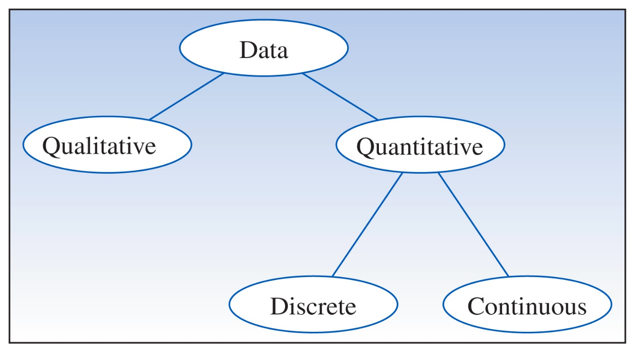
Types of Data
Notes:
Figure 1.2, p. 14

Slide 10
Qualitative Variables
Measure a quality or characteristic on each experimental unit
Examples:
Hair colour (black, brown, blonde…)
Make of car (Dodge, Honda, Ford…)
Gender (male, female)
Province of birth (Alberta, Ontario…)

Slide 11
Quantitative Variables
Discrete: if it can assume only a finite or countable number of values
Continuous: if it can assume the infinitely many values corresponding to the points on a line interval

Slide 12
examples
Quantitative discrete: for each orange tree in a grove, the number of oranges is measured
Quantitative discrete: for a particular day, the number of cars entering a college campus is measured
Quantitative continuous: time until a light bulb burns out

Slide 13
Graphing Qualitative Variables
Use a data distribution to describe:
What values of the variable have been measured
How often each value has occurred:
Frequency
Relative frequency = Frequency/n
(where n = sample size)
Percent = 100 × Relative frequency

Slide 14
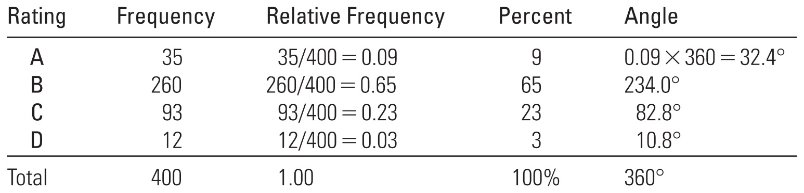
Graphs for Categorical Data
Example: in a survey concerning public education, 400 school administrators were asked to rate the quality of education in Canada
Notes:
Table 1.2, p. 15

Slide 15
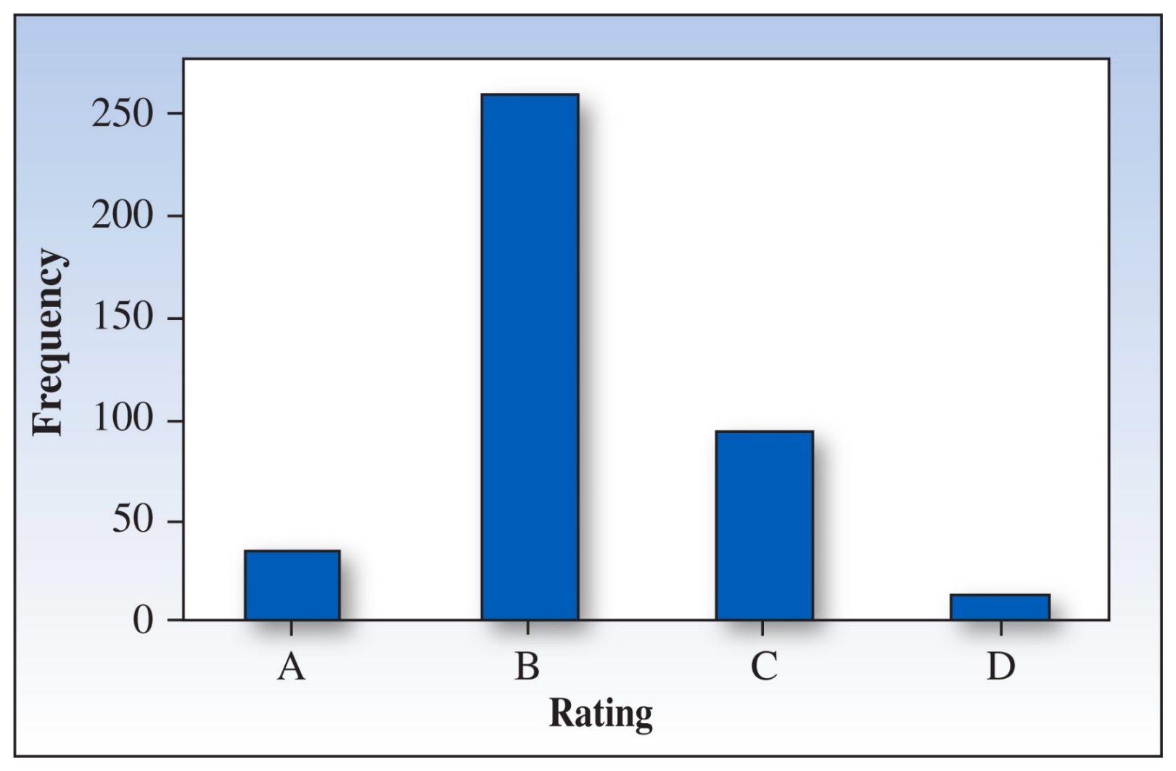
Graph Types: Bar Chart
Notes:
Figure 1.4, p. 16

Slide 16
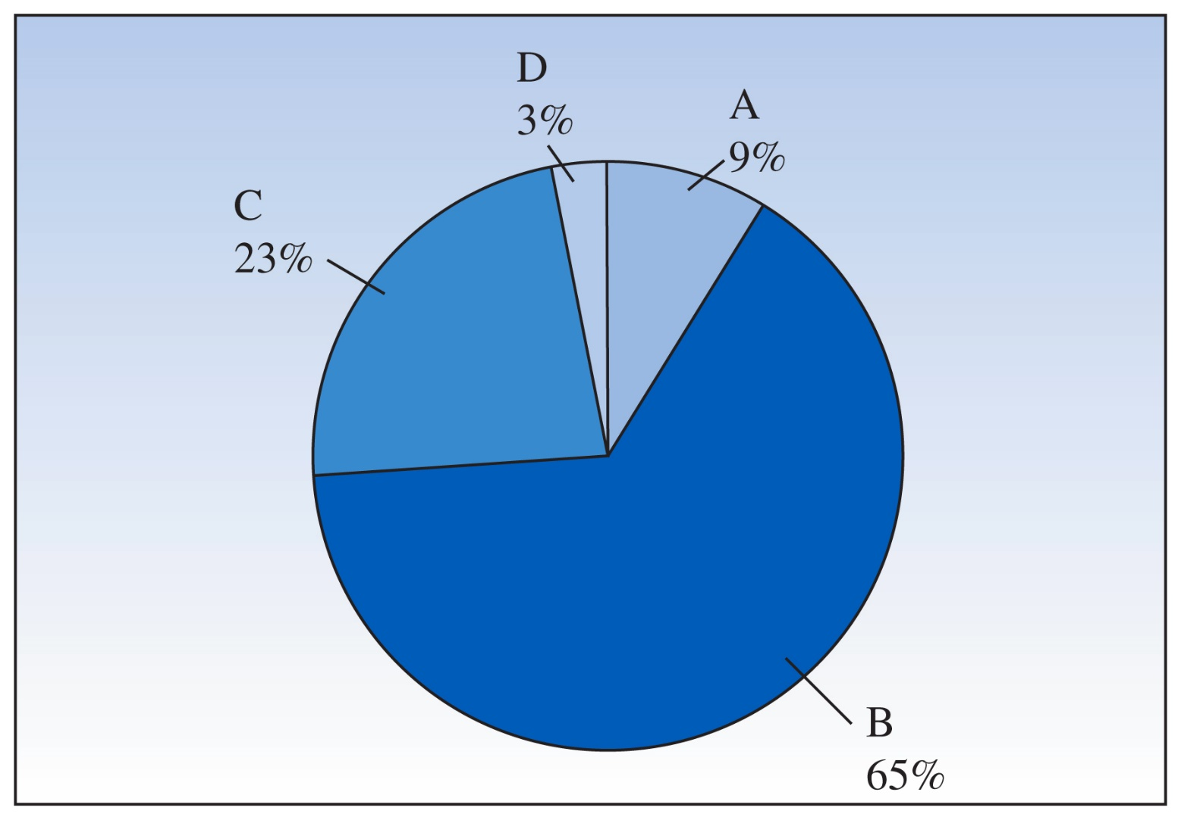
Pie Chart
Angle = Relative Frequency×360°
Notes:
Figure 1.3, p. 16

Slide 17
A bag of M&Ms contains 21 candies:
m
m
m
m
Raw data:
Statistical table:
m
m
m
m
m
m
m
m
m
m
m
m
m
m
m
m
m
Colour | Tally | Frequency | Relative Frequency | Percent
Red |  | 2 | 2/21 = .1 | 10%
Blue |  | 5 | 5/21 = .24 | 24%
Green |  | 3 | 3/21 = .14 | 14%
Orange |  | 3 | 3/21 = .14 | 14%
Brown |  | 6 | 6/21 = .28 | 28%
Yellow |  | 2 | 2/21 = .1 | 10%
m
m
m
m
m
m
m
m
m
m
m
m
m
m
m
m
m
m
m
m
m

Slide 18
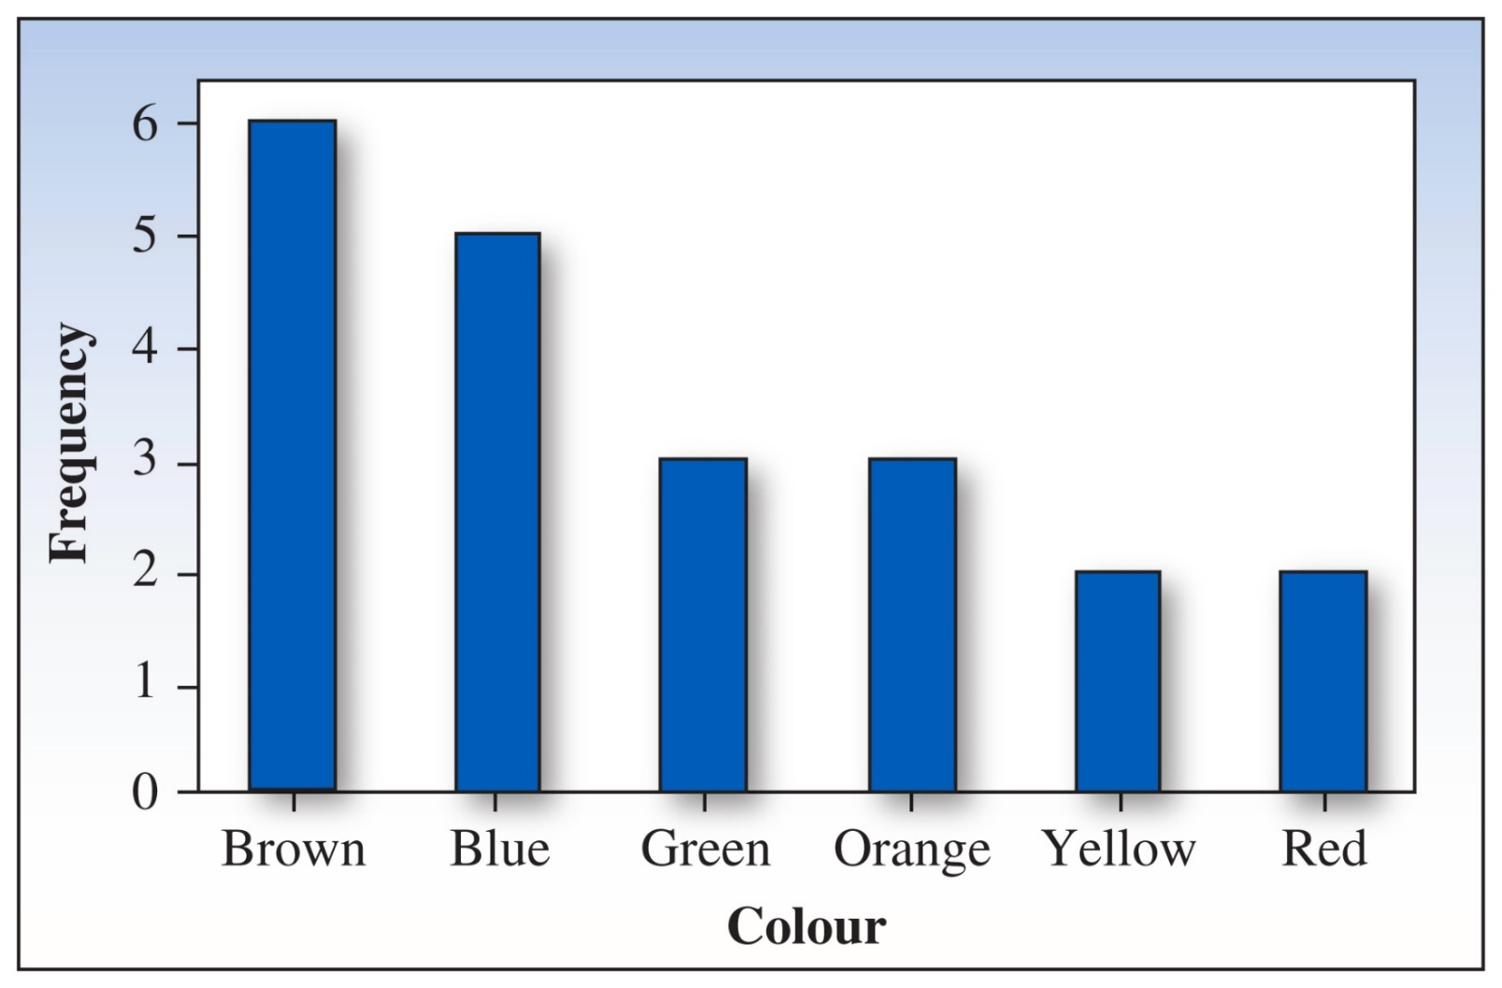
Pareto Chart
Notes:
Figure 1.5, p. 17
A bar chart in which the bars are ordered from largest to smallest

Slide 19
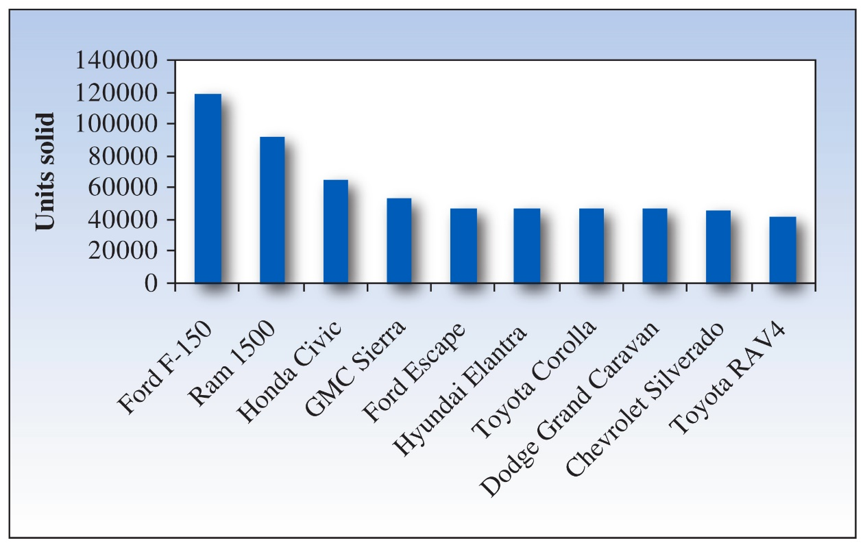
Graphing Quantitative Variables
A single quantitative variable measured for different population segments or for different categories of classification can be graphed using a pie or bar chart
The top 10 vehicles sold in Canada for 2015

Slide 20
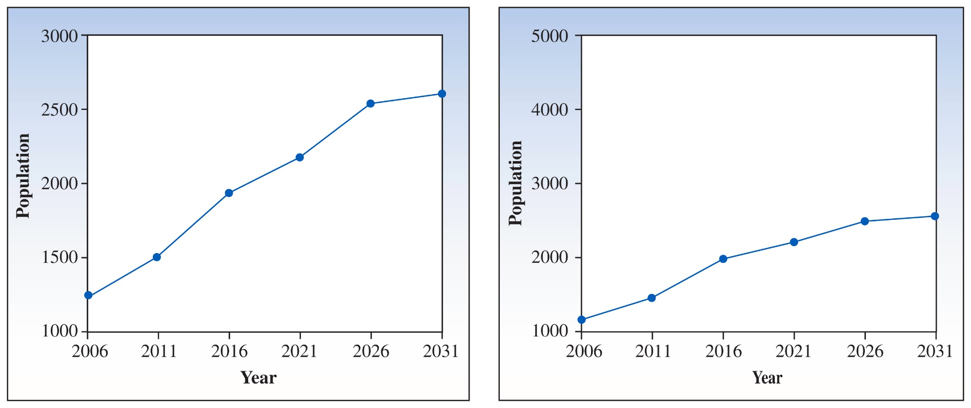
Graphing Time Series Example
Time series: a single quantitative variable measured over time; can be graphed using a line or bar chart
Canadian population growth projections for age group 65–69
Notes:
Figure 1.8, p. 22
Notice the marked difference in the vertical scales of the two graphs. Shrinking the scale on the vertical axis causes large changes to appear small, and vice versa.

Slide 21
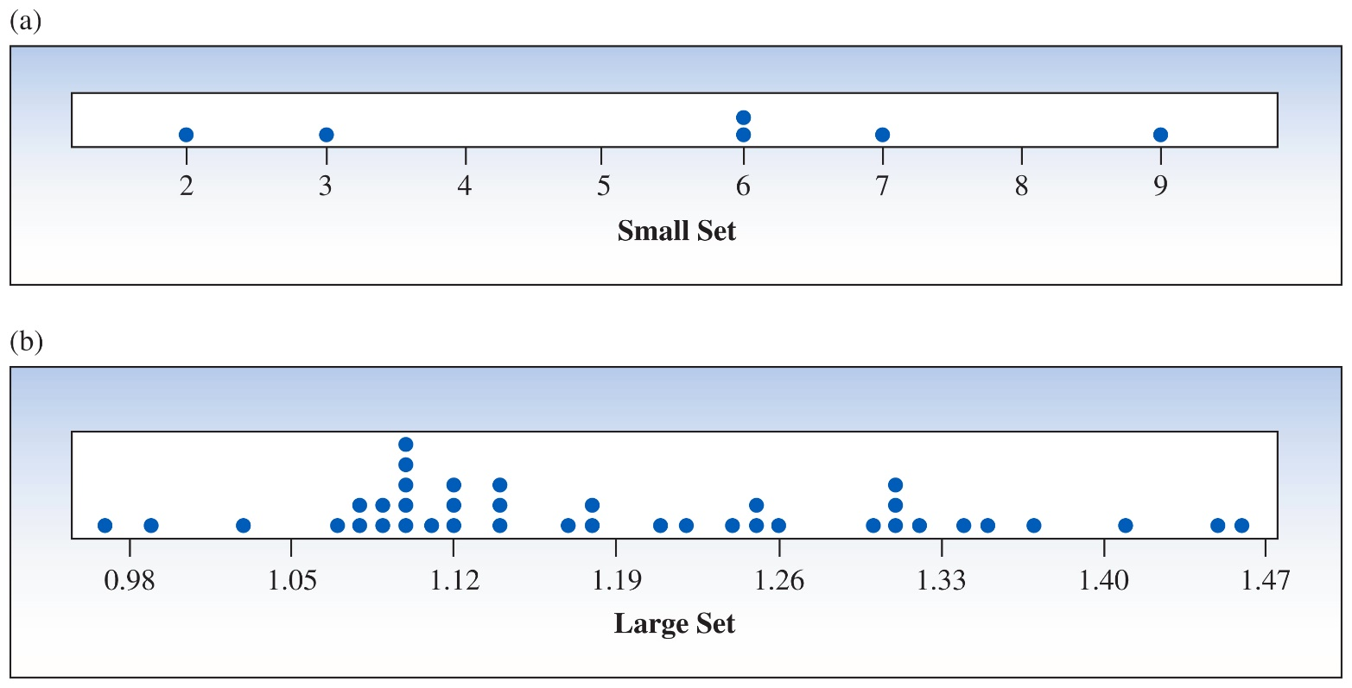
Dotplots
The simplest graph for quantitative data, dotplots plot the measurements as points on a horizontal axis, stacking the points that duplicate existing points

Slide 22
Stem and Leaf Plots
A simple graph for quantitative data that uses the actual numerical values of each data point
Divide each measurement into two parts: the stem and the leaf
List the stems in a column, with a vertical line to their right
For each measurement, record the leaf portion in the same row as its matching stem
Order the leaves from lowest to highest in each stem
Provide a key to your coding

Slide 23
Sample Stem and Leaf Plot
The prices ($) of 19 brands of walking shoes:
90 70 70 70 75 70 65 68 60
74 70 95 75 70 68 65 40 65 70
4 0
5
6 0 5 5 5 8 8
7 0 0 0 0 0 0 0 4 5 5
8
9 0 5
4 0
5
6 5 8 0 8 5 5
7 0 0 0 0 5 0 4 0 5 0
8
9 0 5
Reorder

Slide 24
Interpreting Graphs: Location and Spread
Where is the data centred on the horizontal axis, and how does it spread out from the centre?

Slide 25
Interpreting Graphs: Shapes
Mound shaped and symmetric (mirror images)
Skewed right: a few unusually large measurements
Skewed left: a few unusually small measurements
Bimodal: two local peaks

Slide 26
Interpreting Graphs: Outliers
Are there any strange or unusual measurements that stand out in the data set?
No Outliers
Outlier

Slide 27
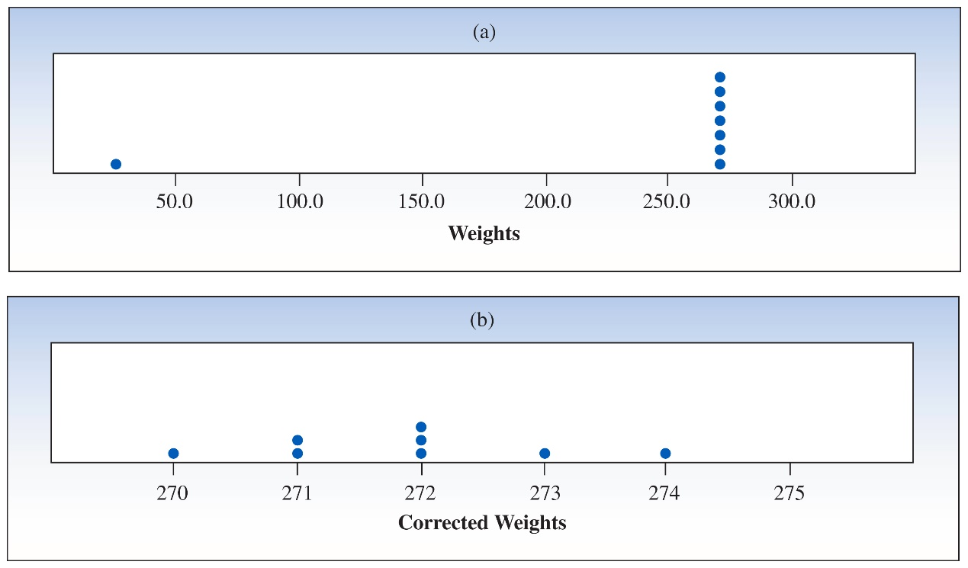
Example
A quality control analyst records the weights (in grams) of 8 randomly selected walking shoes but accidentally misplaces the decimal point in the last entry: 272, 274, 270, 271, 271, 273, 272, 27.2

Slide 28
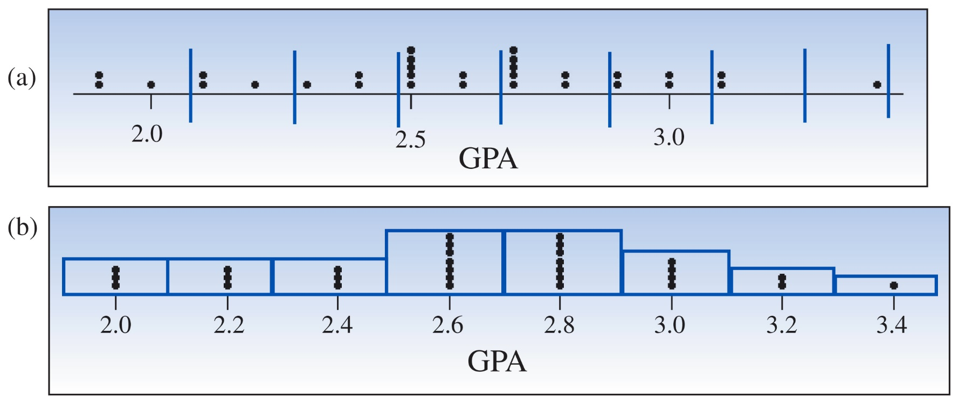
Relative Frequency Histograms
A bar graph in which the height of the bar shows how often measurements fall in a particular class or subinterval

Slide 29
Relative Frequency Histograms Process
Divide the range of the data into 5–12 subintervals of equal length
Calculate the approximate width of the subinterval as range/number of subintervals
Round the approximate width up to a convenient value
Use the method of left inclusion, including the left endpoint but not the right, in your tally

Slide 30
Relative Frequency Histograms Process (cont’d)
Create a statistical table including the subintervals, their frequencies, and relative frequencies
Draw the relative frequency histogram, plotting the subintervals on the horizontal axis and the relative frequencies on the vertical axis

Slide 31
The height of a bar represents:
The proportion of measurements falling in that class or subinterval
The probability that a single measurement, drawn at random from the set, will belong to that class or subinterval

Slide 32
Relative Frequency Histograms
If the data are discrete, one class might be assigned for each integer value taken on by the data
A large number of integer values may need to be grouped into classes

Slide 33
Example
Grade Point Averages of 30
First-Year University Students
2.0 3.1 1.9 2.5 1.9 2.3 2.6 3.1 2.5 2.1
2.9 3.0 2.7 2.5 2.4 2.7 2.5 2.4 3.0 3.4
2.6 2.8 2.5 2.7 2.9 2.7 2.8 2.2 2.7 2.1
We choose to use 8 intervals
Minimum class width = (3.4 – 1.9)/8 = 0.1875

Slide 34
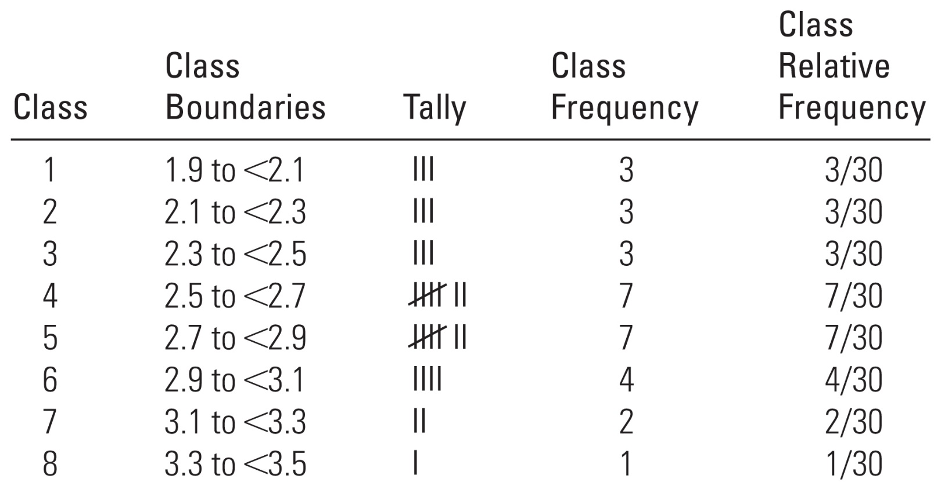
Relative Frequencies of GPA Data
Convenient class width = 0.2
Use 8 classes of length 0.2, starting at 1.9

Slide 35
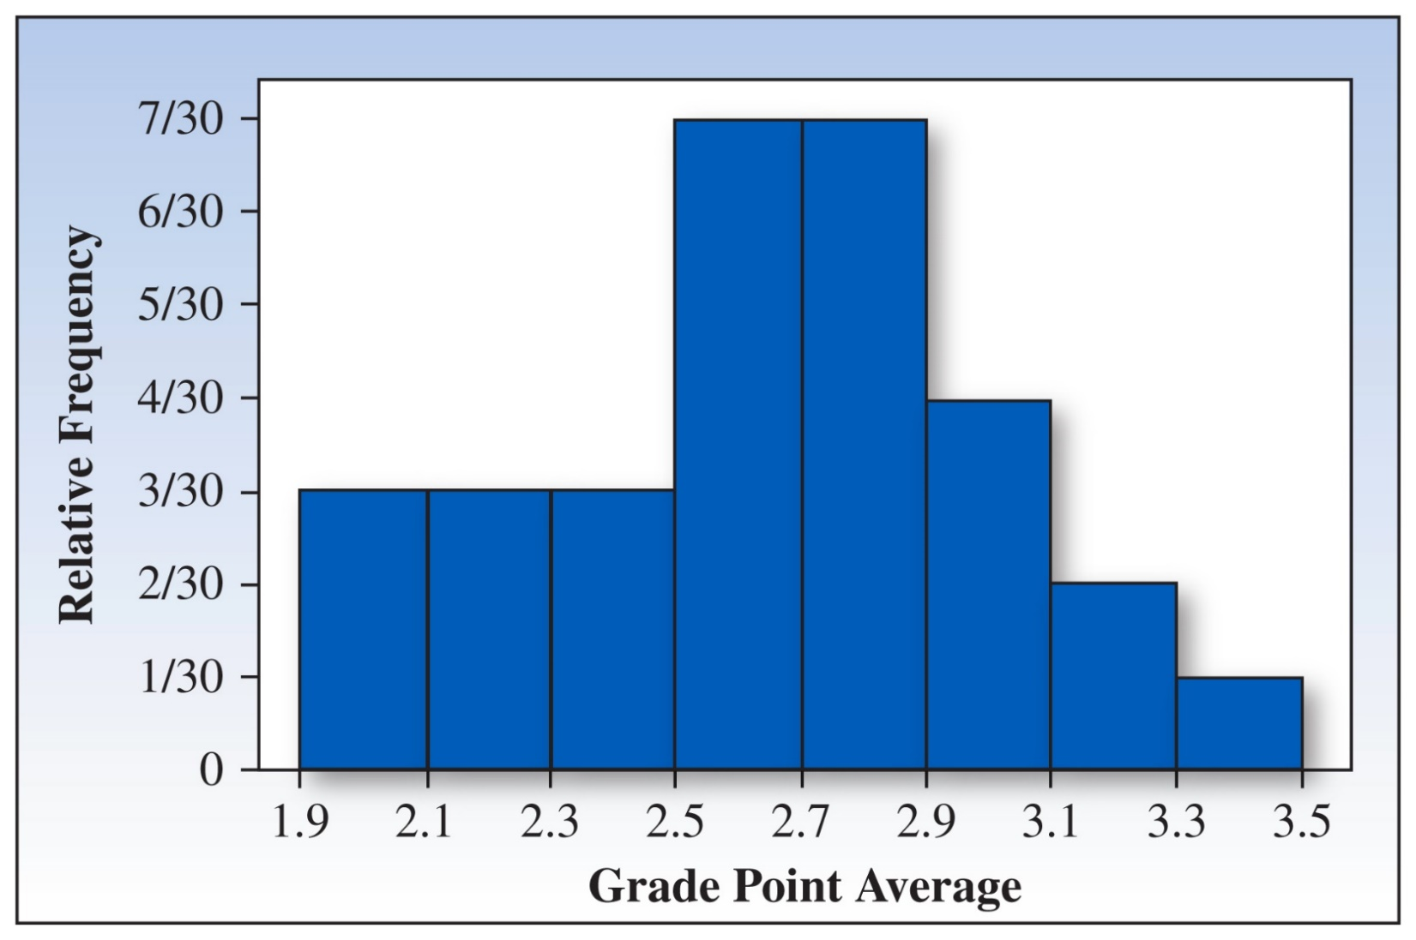
Relative Frequency Histogram
Notes:
Figure 1.15, p. 29
Bar graph from data in GPA example

Slide 36
Describing the Distribution
Shape? | Relatively symmetric
Outliers? | No
What proportion of the students had GPAs of 2.7 or higher? | (7 + 4 + 2 + 1)/30 = 14/30 = 0.47
What is the probability that a randomly selected student had a GPA of 2.7 or higher? | (7 + 4 + 2 + 1)/30 = 14/30 = 0.47

Slide 37
Chapter Review: Key Concepts, Part I
I. How Data Are Generated
1. Experimental units, variables, measurements
2. Samples and populations
3. Univariate, bivariate, and multivariate data
Notes:
37

Slide 38
Chapter Review: Key Concepts, Part II
II. Types of Variables
1. Qualitative or categorical
2. Quantitative
a. Discrete
b. Continuous

Slide 39
Chapter Review: Key Concepts, Part III
III. Graphs for Univariate Data Distributions
1. Qualitative or categorical data
a. Pie charts b. Bar charts
2. Quantitative data
a. Pie and bar charts b. Line charts
c. Dotplots d. Stem and leaf plots
e. Relative frequency histograms
Notes:
39

Slide 40
Chapter Review: Key Concepts, Part III (cont’d)
3. Describing data distributions
a. Shapes—symmetric, skewed left, skewed right, unimodal, bimodal
b. Proportion of measurements in certain intervals
c. Outliers
Notes:
40

